Slide 1
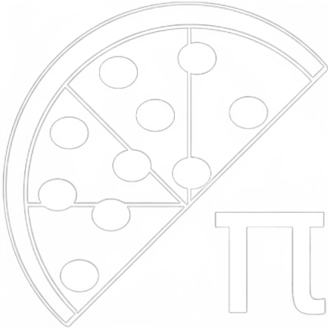
MyPi: A Large Pizza Order Generator
By Jackson Hacker and Baru Yogesh
Advisor: Dr Badri Vellambi

Slide 2
Background
When someone orders pizza for a group, they usually order cheese and pepperoni pizzas because they know that no one will complain.
Our application seeks to go beyond, and empower users to be satisfied by the pizza that they will love instead of settling for the basics.
The underlying problem in this app is to match a group of people with preferences to a set of pizzas that will satisfy everyone’s unique preferences.
We came up with this idea back in 2021 for a hackathon, but our implementation was scrappy.

Slide 3
Goals
Develop a practical, working algorithm for matching people to pizzas based on a set of preferences.
Additionally, the algorithm should be time-efficient, generating orders in a reasonable amount of time.
Develop a backend service for tracking user preferences and generating pizza orders.
Present a polished, working mobile app with full pizza-order-generation functionality for both event organizers and attendees.

Slide 4
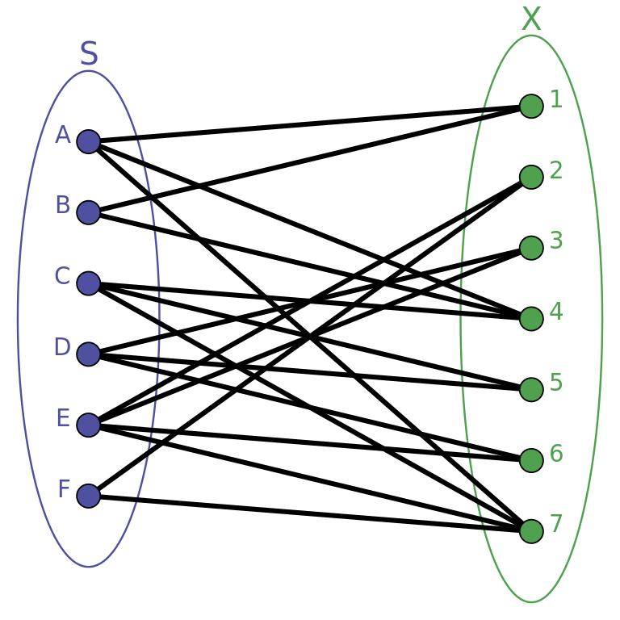
Intellectual Merits: Solving With Graph Theory
Bipartite Graph: set of vertices in two disjoint sets; no two points in a set are connected
Vertex Cover: set of vertices that includes an endpoint of each edge in a graph
We can model our problem as a bipartite graph that maps people to candidate pizzas.
In the model to the right, S=people, and X=candidate pizzas
Perform a modified vertex cover on the graph by selecting pizzas from X that cover a large number of people in S until everyone in S is covered.
The pizzas we select make up the pizzas in the order, and the number of people covered can be used to determine how many of that pizza to order

Slide 5
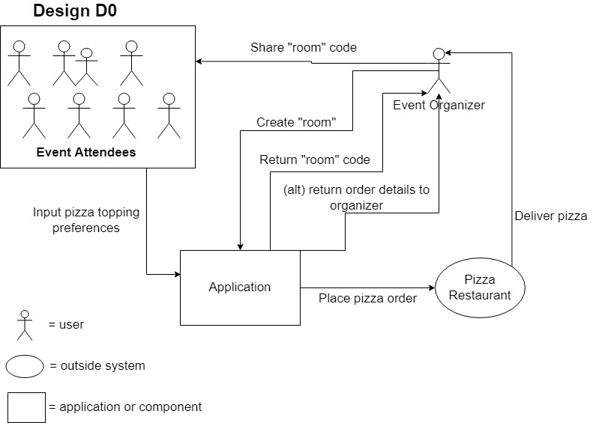

Slide 6
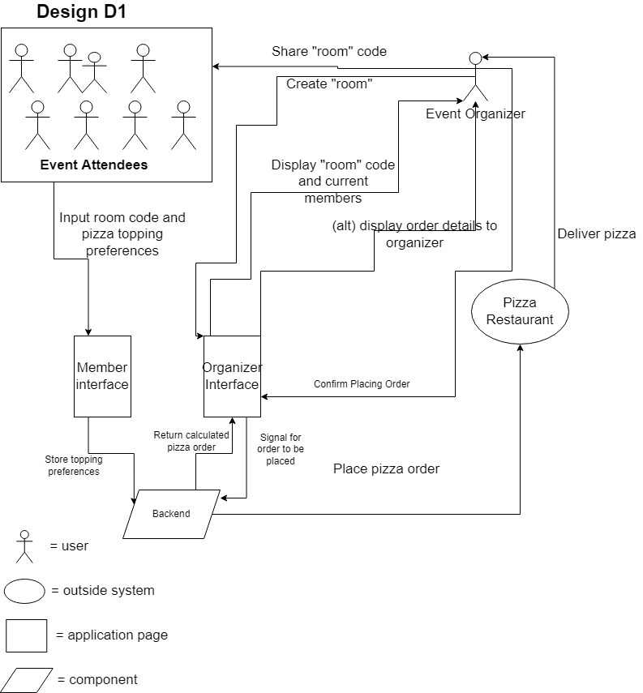

Slide 7
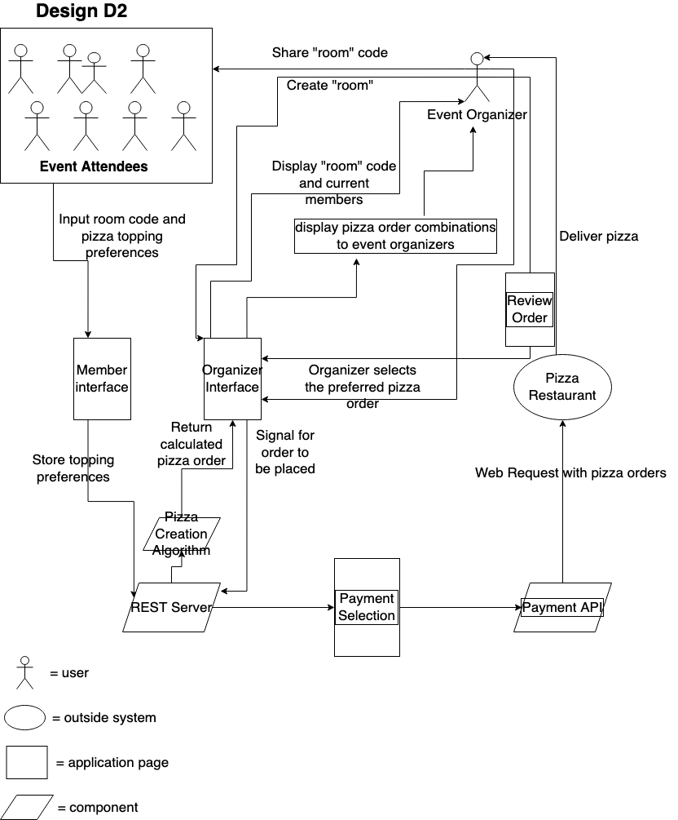

Slide 8
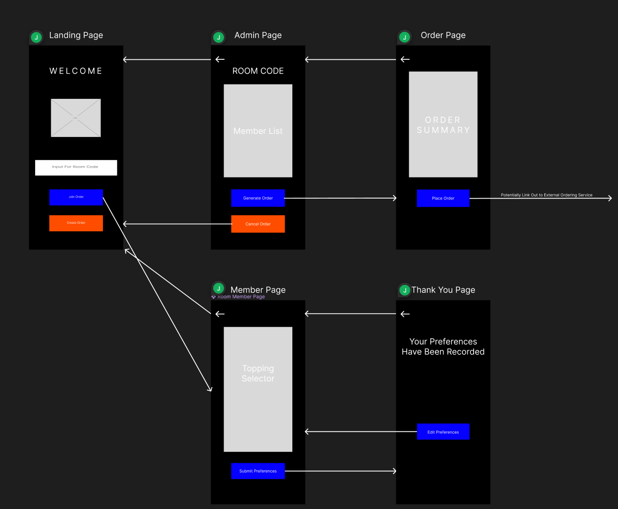
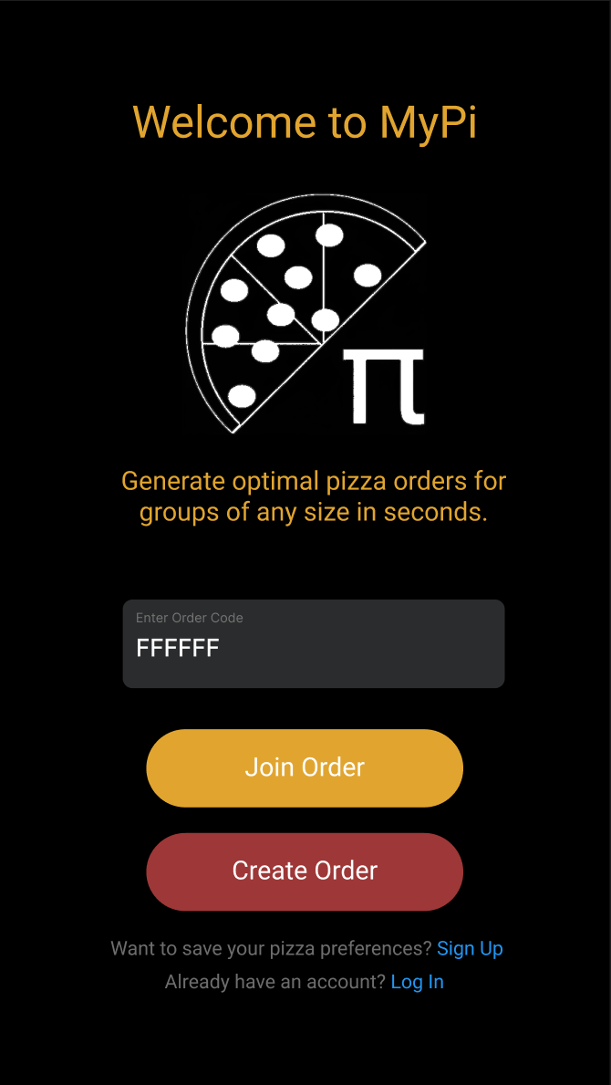
UI Concepts and Wireframes

Slide 9




Technologies

Slide 10
Milestones
UI mockups and wireframes- Done 1/16/23
Pizza generation algorithm concepts- Done 1/24/23
Pizza generation algorithm (greedy version) in Python- Done 2/13/23
Mobile App screens and flow- Done 2/16/23
To Be Finished:
Finish backend API
Hook frontend to backend
Iterate on algorithm, improve “greediness”
Stretch Goal:
Integrate food ordering service to place orders within app

Slide 11
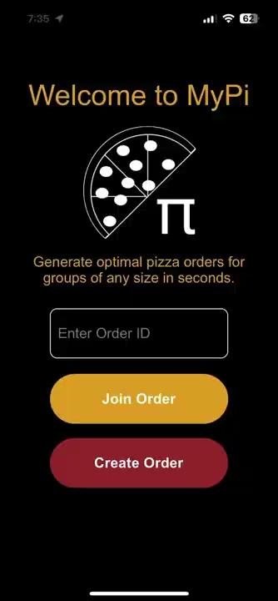
Results
Greedy version of set-matching algorithm in Python
Mobile App flow implemented
DEMO:
Sample Mobile App Flow (With Mock Data)

Slide 12
Challenges
Main challenges are in algorithm implementation:
Performing a uniquely different vertex cover than those discussed by most literature (minimum vertex cover is close to our problem, but not exactly)
Balancing the “greediness” of the algorithm, as in when it should prefer to cover more people with a pizza vs the granularity of preferences it covers
Time/space complexity of algorithm, many permutations of different pizzas possible given N toppings, and need to iterate through them efficiently (we used sorting and heaps)

